Slide 1

Polymer or not Polymer that is the question
DataArt Summer School 2015
Alexander Kasheverov

Slide 2

Who am I

Slide 3
Plan
Intro
Web Components
Polymer
Live Example
Conclusion
Homework

Slide 4
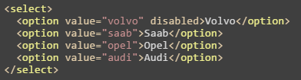
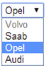
It all starts with elements

Slide 5
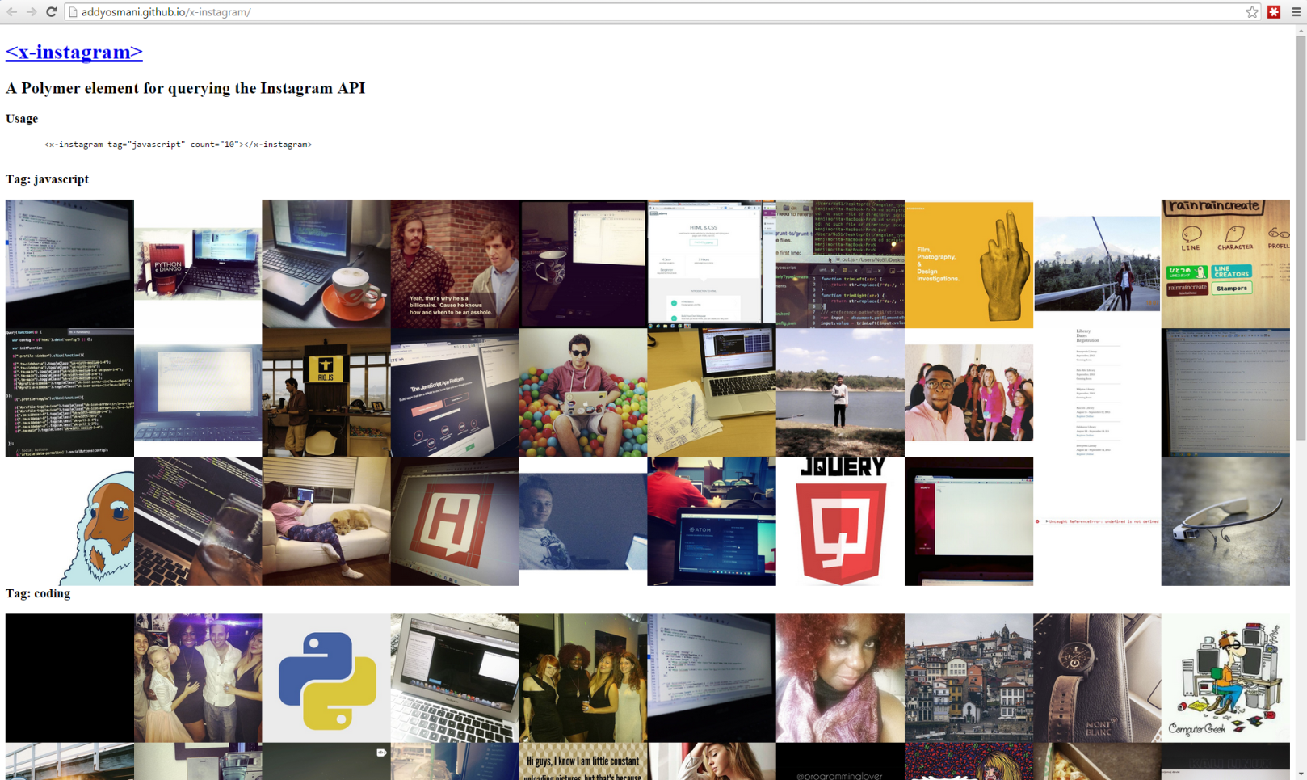
It all starts with elements
<x-instagram tag="javascript" count="10"></x-instagram>
addyosmani.github.io/x-instagram/

Slide 6
It all starts with elements

Slide 7
Web components
First draft in 2012
Custom elements
Templates
Shadow DOM
Html imports
It brings native component-based solutions in browsers

Slide 8
Web components -> Custom elements
var XFoo = document.registerElement('x-foo', {
prototype: Object.create(HTMLElement.prototype, {
bar: { get: function() { return 5; } },
foo: { value: function() { alert('foo() called'); } }
})
});
<x-foo></x-foo>
var xfoo = document.createElement('x-foo');
document.body.appendChild(xfoo);

Slide 9
Web components -> Custom elements
var MegaButton = document.registerElement(‘mega-button', {
prototype: Object.create(HTMLButtonElement.prototype),
extends: 'button'
});
<button is="mega-button">
var btn = document.createElement( 'button', 'mega-button‘ );

Slide 10
Web components -> Templates
<template id="mytemplate">
<img src="" alt="great image">
<div class="comment"></div>
</template>
// Populate the src at runtime.
var t = document.querySelector('#mytemplate');
t.content.querySelector('img').src = 'logo.png';
var clone = document.importNode(t.content, true);
document.body.appendChild(clone);
Template is totally hidden until is used
There's no way to "prerender" a template, meaning you cannot preload assets, process JS, download initial CSS, etc
Nested templates require that their children also be manually activated

Slide 11
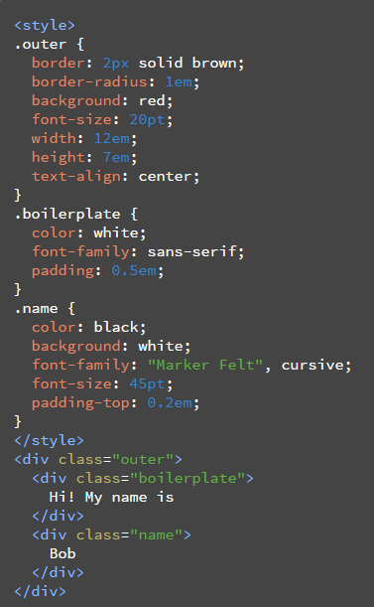
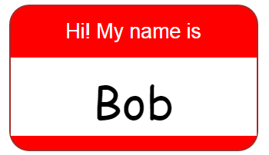
Web components -> Shadow DOM
Hide Presentation Details

Slide 12
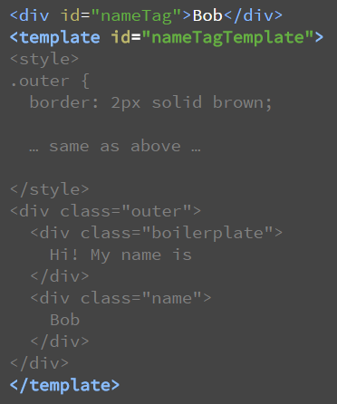
Web components -> Shadow DOM
<script>
var shadow = document.querySelector('#nameTag').createShadowRoot();
var template = document.querySelector('#nameTagTemplate');
var clone = document.importNode(template.content, true);
shadow.appendChild(clone);
</script>

Slide 13
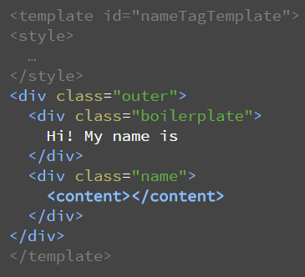
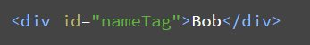
Web components -> Shadow DOM
Separate Content from Presentation

Slide 14
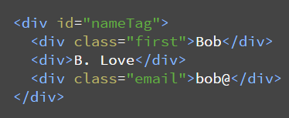
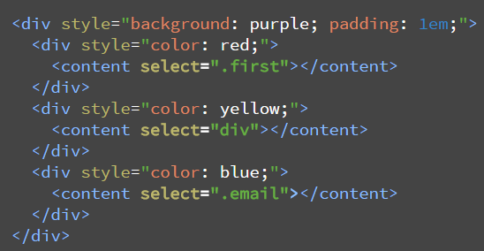
Web components -> Shadow DOM
Document
Shadow root

Slide 15
Web components -> Html imports
How to load different types of resources?
<script src>
<link rel="stylesheet">
<img>
<video>
<audio>
<iframe>
AJAX
???

Slide 16
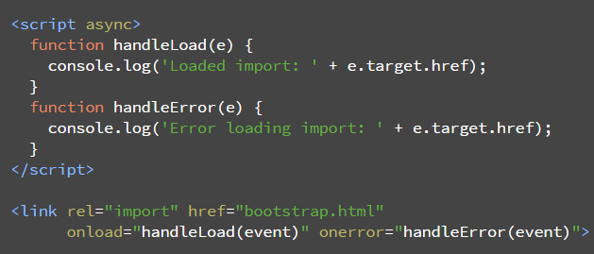
Web components -> Html imports
A new one:
<link rel="import" href="/path/to/imports/stuff.html">
Instead of loading each html/css/js for Bootstrap separately you could import just an html file

Slide 17
Web components support by browser
Works in evergreen browsers (which have auto-update)
And what about others?

Slide 18
Polymer
It’s not a framework
Adds shims for browsers that don’t support web components
Adds sugar
A slogan `we have an element for that`
Updated this year to version 1.0
Less code 35% overall
Speed increased 3x (chrome), 4x (mobile safari)

Slide 19
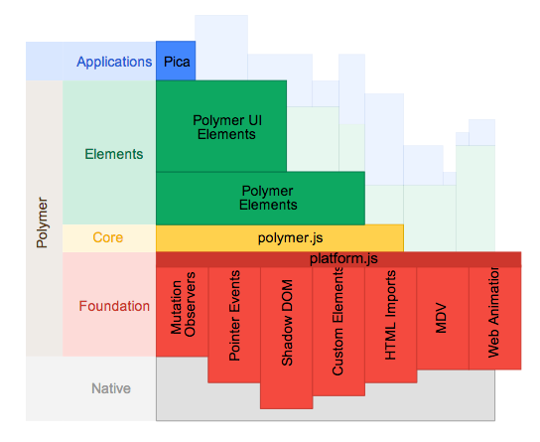
Polymer

Slide 20
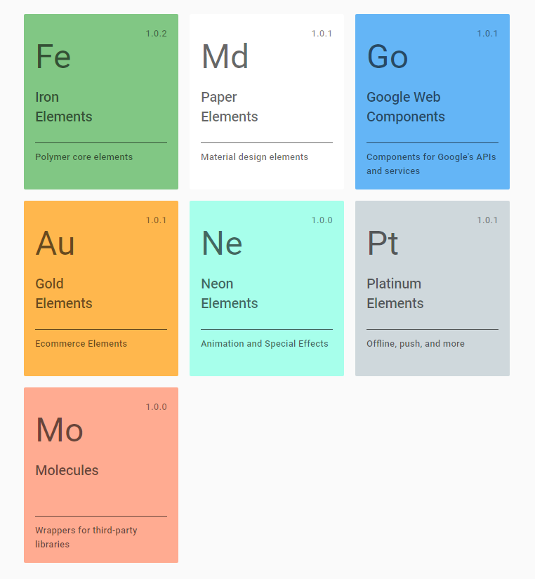
Elements

Slide 21
Elements -> iron elements
<iron-ajax
auto url="http://gdata.youtube.com/feeds/api/videos/"
params='{"alt":"json", "q":"chrome"}'
handle-as="json"
on-response="handleResponse"
debounce-duration="300">
</iron-ajax>
<iron-icon src="star.png"></iron-icon>
<iron-media-query query="(min-width: 600px)" query-matches="{{queryMatches}}">
</iron-media-query>

Slide 22
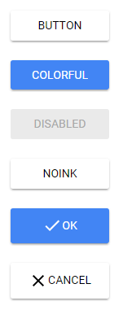
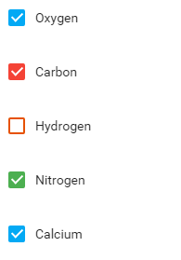
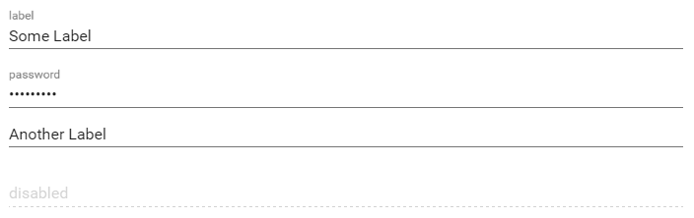
Elements -> paper elements
<paper-button>flat button</paper-button>
<paper-button raised>raised button</paper-button>
<paper-button noink>No ripple effect</paper-button>
<paper-input error-message="Invalid input!" label="Input label">
</paper-input>
<paper-checkbox checked> label</paper-checkbox>

Slide 23
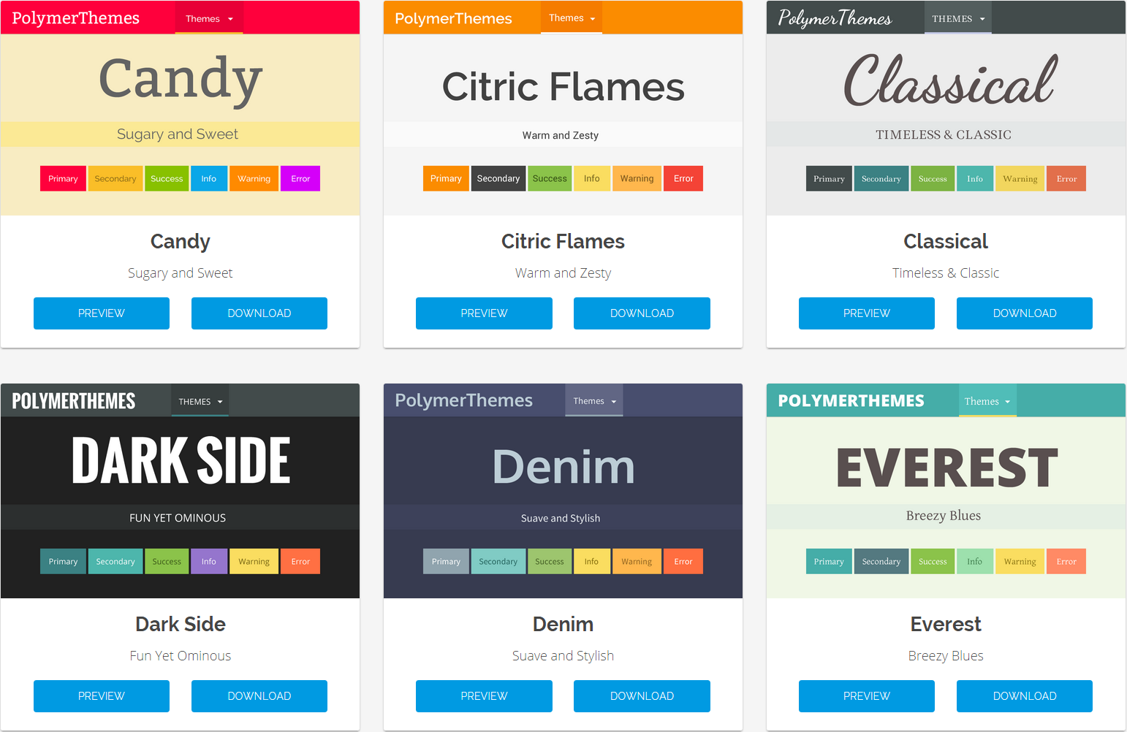
Elements -> paper elements
https://polymerthemes.com/

Slide 24
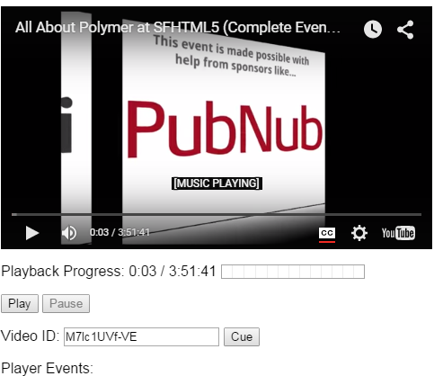
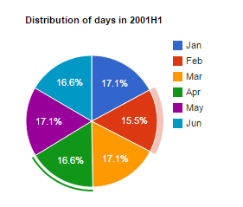
Elements -> google web components
<google-youtube
video-id="..."
height="270px"
width="480px"
rel="0"
start="5"
autoplay="1">
</google-youtube>
<google-chart
type='pie'
options='{"title": "Distribution of days in 2001H1"}'
cols='[{"label":"Month", "type":"string"}, {"label":"Days", "type":"number"}]'
rows='[["Jan", 31],["Feb", 28],["Mar", 31]]'>
</google-chart>

Slide 25
Alternatives
http://x-tags.org/
http://bosonic.github.io/

Slide 26
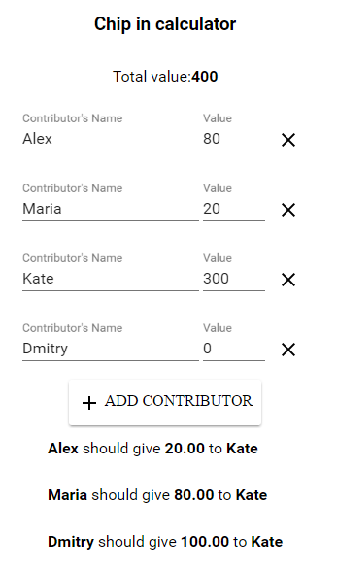
Example

Slide 27
Installation
Install node + npm
npm install –save bower
bower init
bower install --save Polymer/polymer#^1.0.0
Installed in a `bower_components` folder
OR
Manually download/unpack from here polymer-project.org

Slide 28
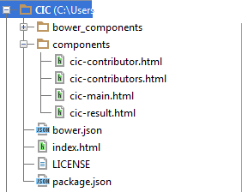
Structure

Slide 29
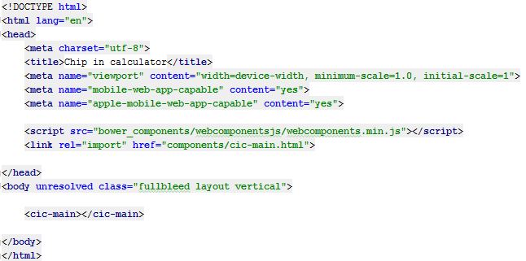
index.html

Slide 30
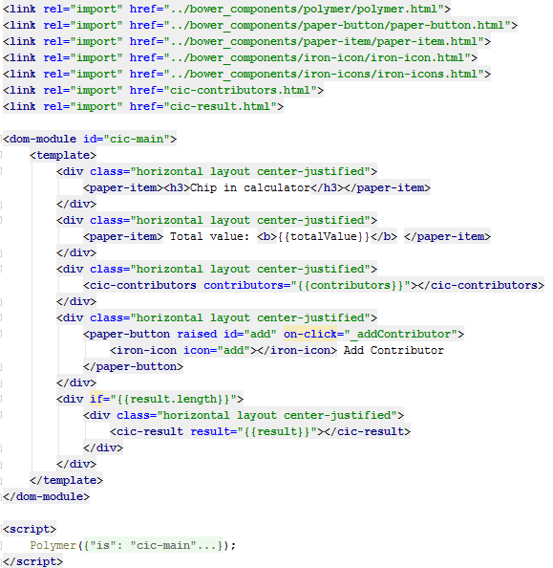
components/cic-main.html

Slide 31
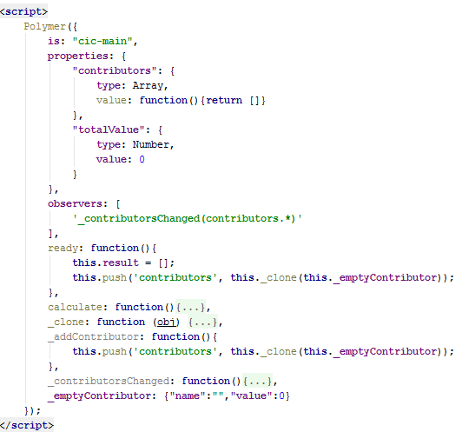
components/cic-main.html

Slide 32
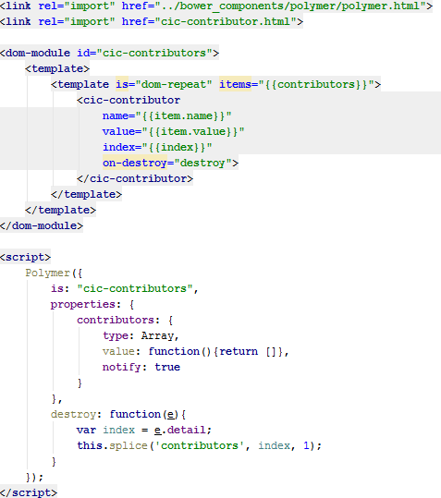
components/cic-contributors.html

Slide 33
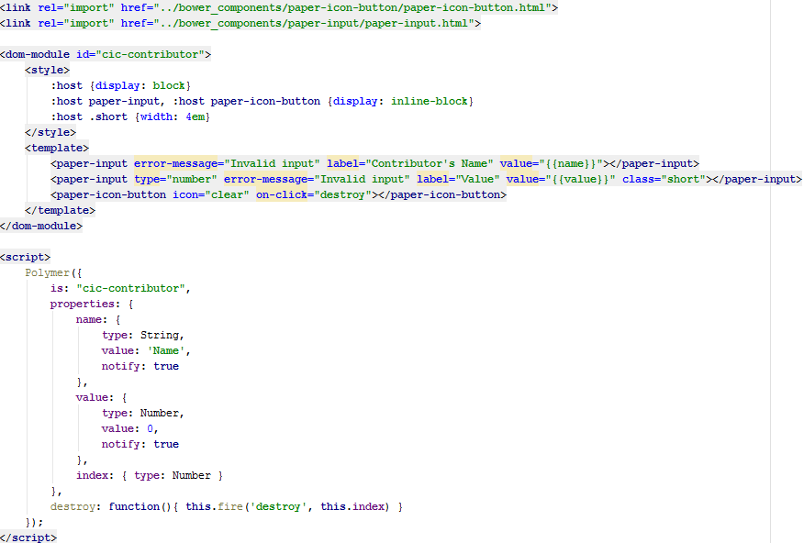
components/cic-contributor.html

Slide 34
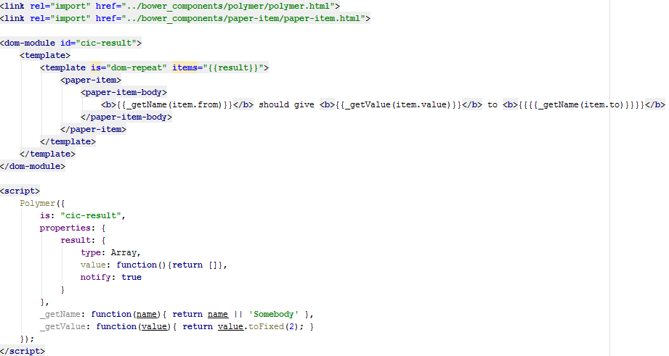
components/cic-result.html

Slide 35
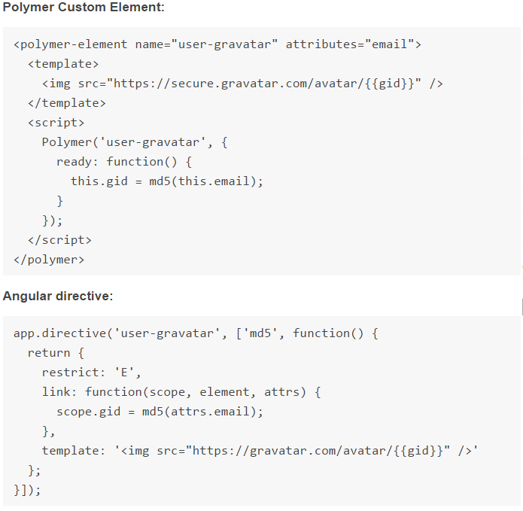
Angular vs Polymer

Slide 36
Questions
?

Slide 37
Useful links
Web components & Polymer
webcomponents.org
jonrimmer.github.io/are-we-componentized-yet/
www.html5rocks.com/en/
polymer-project.org
Chip-in calculator
chip-in.me
code: github.com/kashesandr/CIC

Slide 38
Homework -> weather-yahoo
1. Basic
Create a custom-element which shows weather in a city provided via element’s property
2. Advanced
Create a custom-element which uses the custom element above to show weather in list of cities
3. Expert
Create an editable list of cities (add, edit, remove), selecting on one of them the weather should be shown
Weather API https://developer.yahoo.com/weather/
Might be helpful http://todomvc.com/examples/polymer/index.html

